Slide 1
Literature Survey
Healthcare Telepresence Robot
Team 14

Slide 2
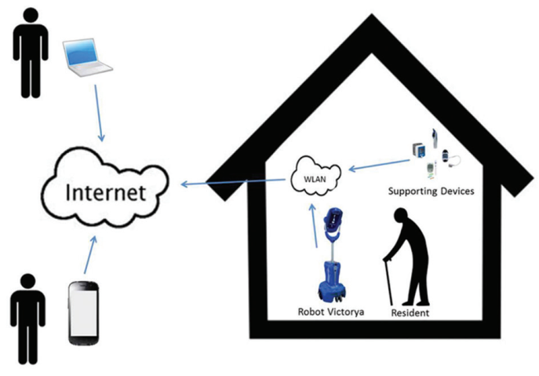
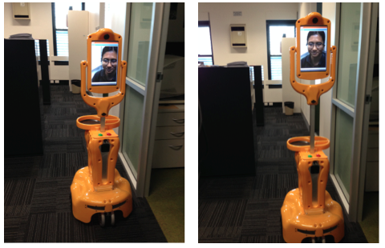
Latest Achievements
A new mobile communication method
Integrated video-mediated communication tools
Remote control of the robotic system’s movement
Smart sensors
In-home navigation abilities
Newest Products: Giraff Robot
Smart medication dispenser
Fall detector
Android-based App for remote monitoring
Raise the lower the screen

Slide 3
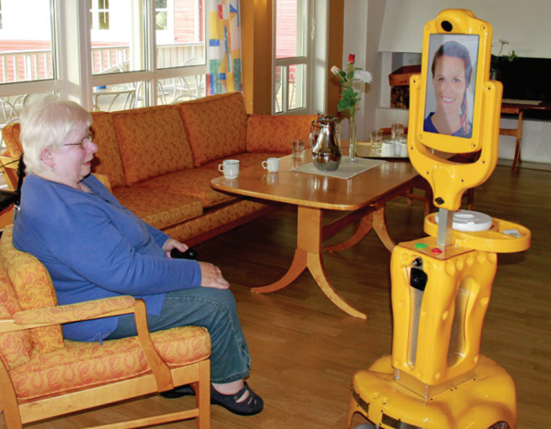
Advantages
Increase old people’s feeling of happiness, self-esteem and reduce their levels of frustration and loneliness
Provide emotional connection between caregivers and old people.
Old people feel safe knowing that someone would come and help when they’re in trouble.
Disadvantage
High cost, more than 5000$
Fall detector malfunction causes many worries
The robot uses a complex network structure may have firewall issues
Video frame rate always drop to make it hard to drive
There is also much drive lag due to the poor network.

Slide 4
Typical Development Method
Key Point: Build Connection
Device to Connect
Arduino
Raspberry
Internal Network Connection
Low cost
Easy to build
Range limitation
External Connection
Need a server
Connection to world wide web
Cover the whole world
Function Realization
Video Connection
Camera
Speaker
microphone
Physical Connection
Motor-controlled arm
Various sensors

Slide 5
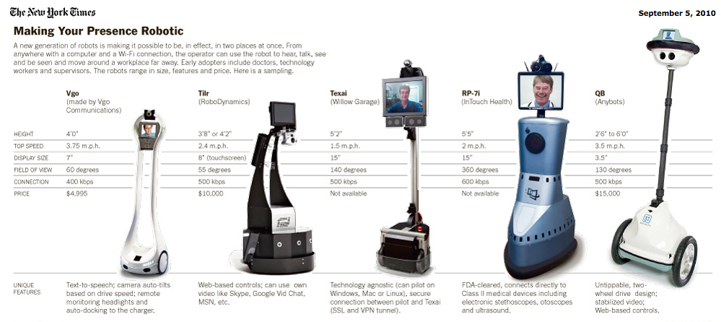
Future for Development
More Cost-effective
Simplify functions
Improve stability for connection by using public servers.
More Application
Remote medical treatment
Exploration to dangerous area.
Remote supervision

Slide 6
Reference
G. Zhang, J. P. Hansen, K. Minakata, A. Alapetite and Z. Wang, "Eye-Gaze-Controlled Telepresence Robots for People with Motor Disabilities," 2019 14th ACM/IEEE International Conference on Human-Robot Interaction (HRI), Daegu, Korea (South), 2019, pp. 574-575.
P. W. Ching, W. C. Yue and G. S. G. Lee, "Design and development of edgar - a telepresence humanoid for robot-mediated communication and social applications," 2016 IEEE International Conference on Control and Robotics Engineering (ICCRE), Singapore, 2016, pp. 1-4.
Donald Kerr, J Artur Serrano, Pradeep Ray, “ The role of a disruptive digital technology for home‑based healthcare of the elderly: Telepresence robot ," Digital Medicine, Year 2018, Volume 4, Issue 4 [p. 173-179]
Key Word: Telepresence Robot
Search engine: Digital Medicine, IEEE/IET Electronic Library

